Slide 1





INTERREG V-A
Romania-Bulgaria Programme
Annual Conference of the Interreg V-A Romania-Bulgaria Programme 2021
29th September 2021, Ruse and online
www.interregrobg.eu

Slide 2




INTERREG V-A Romania – Bulgaria
Fresh ideas for a better eligible area
Since 2015

Slide 3

We work together beyond borders for a
SMARTER
GREENER
SAFER
MORE CONNECTED and
MORE INTEGRATED
Romanian – Bulgarian cross border area

Slide 4

Since 2015, we have been funding 172 projects which address common regional challenges in the fields of environment, infrastructure, culture, risk management and education.
Everyone can now benefit from the solutions that our projects developed!

Slide 5
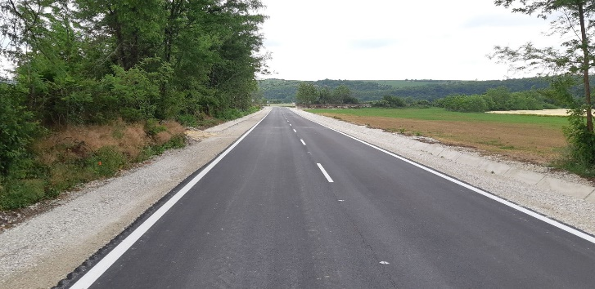
Priority axis 1 – A well connected region
Our infrastructure projects better connect the RoBg cross border area by reducing gaps between peripheral regions and well-connected centres, taking the accessibility forward.

Slide 6
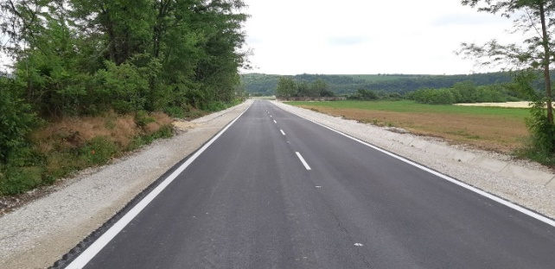
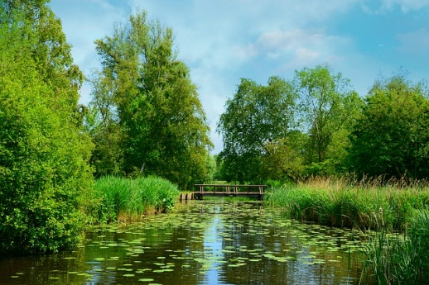
WHAT WE ACHIEVED?
21 funded projects
130 mil EURO
60 km reconstructed or upgraded roads out of 150 km
transport safety on waterways routes
over 600,000 people have benefited from an improved road network leading to TEN-T.
5 studies, strategies and action plans to improve safety of the navigation on the Danube and the Black Sea
2015
2016
2017
2018
2019
2020
2021

Slide 7
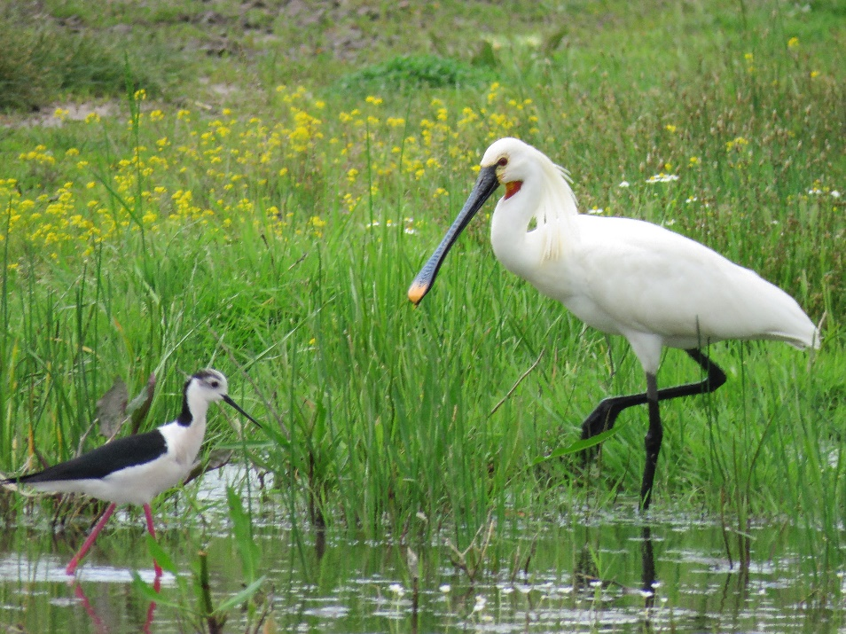
Priority axis 2 – A green region
Our environment and culture projects respond to the need for protecting and sustainably using natural and cultural heritage and heritage.

Slide 8
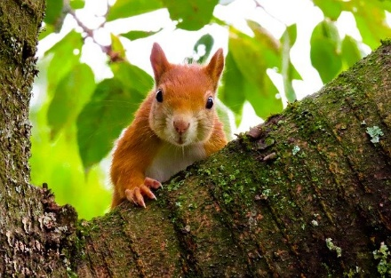

WHAT WE ACHIEVED?
70 funded projects
61 mil EURO
78 integrated tourism products created
44 common strategies
27.000 Ha habitats supported to attain a better conservation
11 NATURA 2000 sites in the cross border area with coordinated management tools
2015
2016
2017
2018
2019
2020
2021
Notes:
These projects have brought the achievement of the indicator No of integrated tourism products/services created to 78 at the end of 2020 (78% out of the set target) and of the indicator No of common strategies, policies or management plans for valorizing the cultural and natural heritage through its restoration and promotion for sustainable economic uses to 44 (58.67% out of a total target).

Slide 9
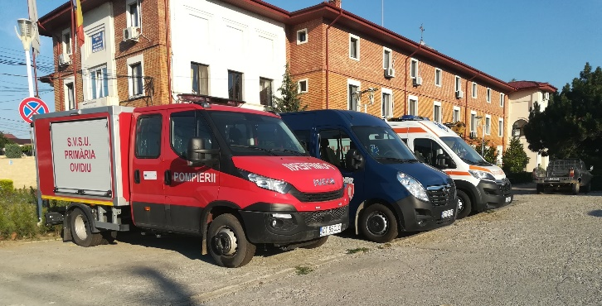
Priority axis 3 – A safe region
Our projects creates a safe and secure environment, protecting the people and assets from potential harm and thus, the future of our RoBg cross border area.

Slide 10
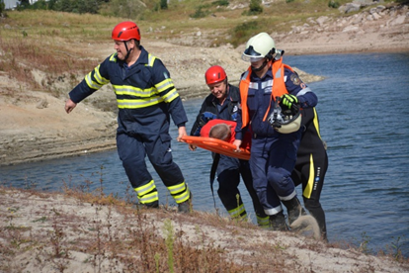
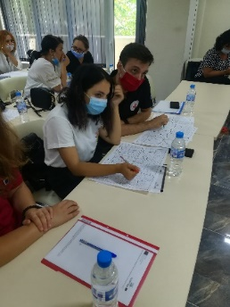
WHAT WE ACHIEVED?
28 funded projects
46 mil EURO
490.000 people benefiting from actions of risk management
10 partnerships for early warning and response
26,716 people are benefiting from flood and forest fire protection measures
2015
2016
2017
2018
2019
2020
2021

Slide 11
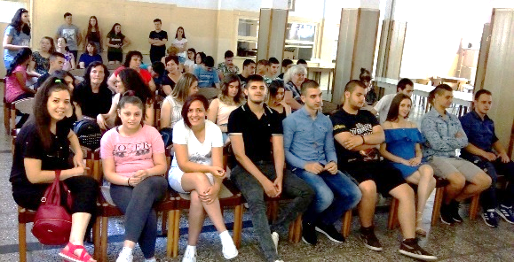
Priority axis 4 – A skilled and inclusive region
Our projects make the RoBg cross border area more innovative and competitive by addressing socio-economic challenges and needs, taking the smart growth forward.

Slide 12
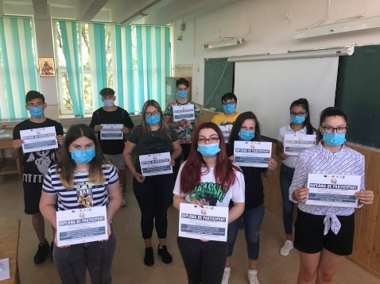

WHAT WE ACHIEVED?
34 funded projects
17 mil EURO
183 initiatives
851.000 persons having access to initiatives
9.000 participants in joint educational and training schemes to support youth employment, educational opportunities
19.000 participants in joint local employment initiatives and joint training
2015
2016
2017
2018
2019
2020
2021

Slide 13

Priority axis 5 – An efficient region
Our projects support effective investments in research, innovation and education by strengthening the links between various actors and by improving their capacities and competences for economic and social innovation.

Slide 14
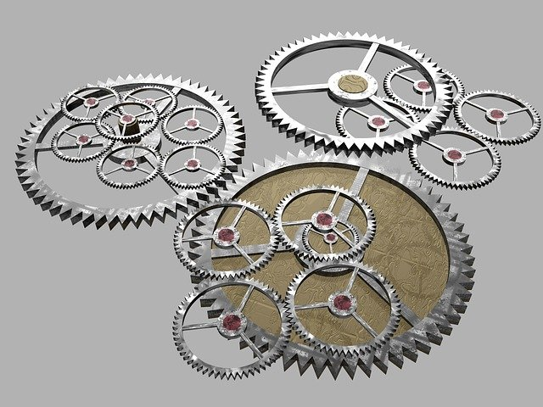
WHAT WE ACHIEVED?
19 funded projects
15 mil EURO
62 supported cross border mechanisms to enhance cooperation capacity
2015
2016
2017
2018
2019
2020
2021

Slide 15
Next programme Interreg VI-A RO-BG
What we achieved so far?
2019 - a Joint Working Group for Strategic Planning and Programming (JWG) was set up at the Programme level
2020 - a new website dedicated to Interreg VI-A RO-BG was created https://interregviarobg.eu/en
2020- the Territorial Analysis of Romania-Bulgaria cross-Border Region was elaborated and published
2020 and 2021 - the following policy objectives were selected for financing:
PO3 – A more connected Europe- PO3 will finance only strategic projects;

Slide 16
Next programme Interreg VI-A RO-BG
What we achieved so far?
2. PO5 - A Europe closer to citizens- the implementation of PO5 will be achieved through an integrated territorial strategy of area, developed by a new established structure, the Strategy Board (SB); the first meeting of SB took place in July 2021
3. PO 2- A greener low-carbon transitioning towards a net zero carbon economy and resilient Europe - actions related to disaster risk prevention and resilience will be financed through strategic projects
4. PO 4- A more social and inclusive Europe - projects designed for improving equal access to inclusive and quality services in education, training and lifelong learning

Slide 17
Next programme Interreg VI-A RO-BG
What we achieved so far?
2021 - the integrated draft of the Programme was published for consultation in August 2021 (the first draft of the Programme was published for consultation in November 2020)
2021 - the SEA procedure was launched in Romania and Bulgaria
For details and updated information on the programming process please consult:
https://interregviarobg.eu/en/partnership

Slide 18


Explore the results of our projects in your city/region on our website
www.interregrobg.eu
and on our social media
RomaniaBulgariaCbcProgramme
RoBgProgramme

Slide 19
THANK YOU FOR YOUR ATTENTION!
Contact us:
Joint Secretariat (CBC RO Calarasi)
Tel: +40 242 313 091
Fax: +40 242 313 092
E-mail: info@calarasicbc.ro
Web: www.calarasicbc.ro, www.interregviarobg.eu

